Slide 1
Creating Requests and Responses

Slide 2


Slide 3
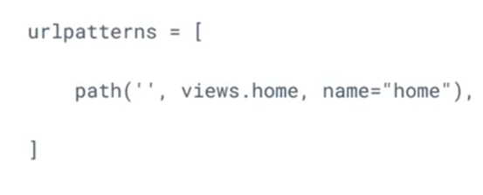
urls.py

Slide 4

views.py

